Slide 1
Neural collaborative filtering – hands on!
Guy Shtar
Shtar (at) bgu.ac.il

Slide 2
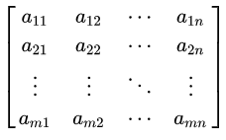
Motivation
1. Item
1. Movie
2. Word
3. Feature
Recommender systems
IMDB, eBay, Netflix, news etc.
Information retrieval
Search engines (you know…)
Dimensionality reduction – many fields
Curse of dimensionality
Mainly when data is sparse
1. User
2. Document
3. Instance

Slide 3

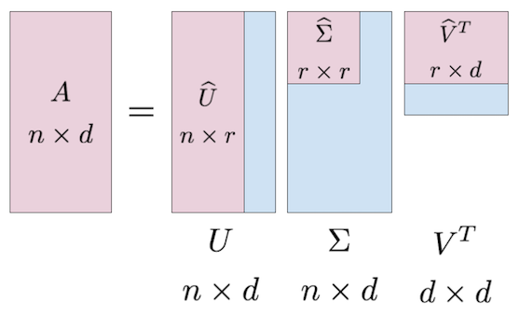
Dimensionality reduction
Well known methods:
Matrix Factorization
Singular value decomposition (SVD)
Similar concepts
Linear

Slide 4
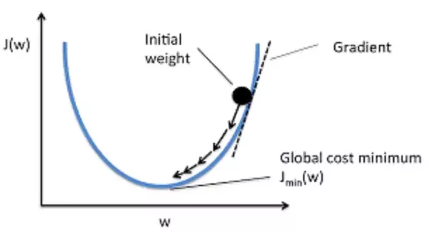
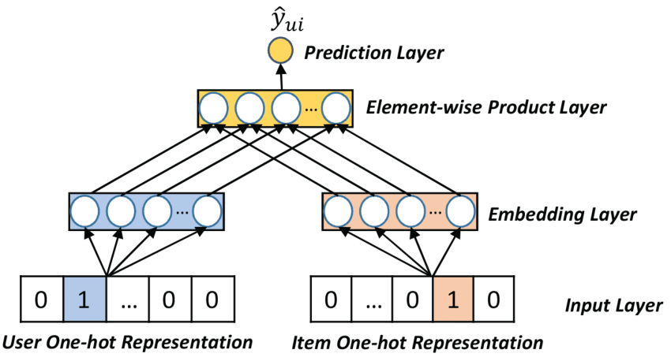
We are here for Neural Networks!
(cell value)
Merge (concatenation\Multiply etc.)
Optimizing
Lower dimension
(Row)
(Col)

Slide 5
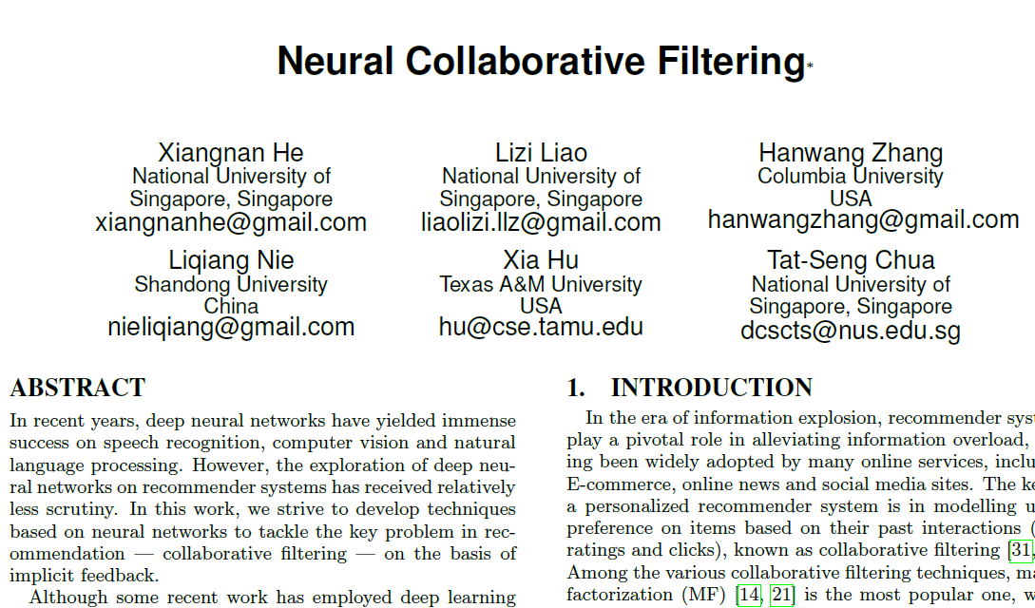
Theoretical basis for today
Xiangnan He, Lizi Liao, Hanwang Zhang, Liqiang Nie, Xia Hu and Tat-Seng Chua (2017). Neural Collaborative Filtering. In Proceedings of WWW '17, Perth, Australia, April 03-07, 2017.
Three collaborative filtering models: Generalized Matrix Factorization (GMF), Multi-Layer Perceptron (MLP), and Neural Matrix Factorization (NeuMF). To target the models for implicit feedback and ranking task, we optimize them using log loss with negative sampling.
Author: Dr. Xiangnan He (http://www.comp.nus.edu.sg/~xiangnan/)

Slide 6
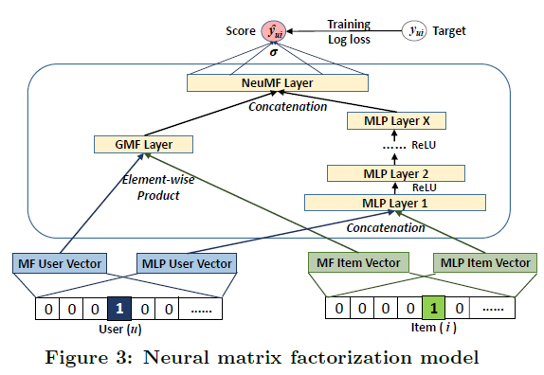
What we are going to code today
MF like linear transformation
Non-linear transformation
Two embedding sets per dimension.

Slide 7

Evaluation
Dataset: MovieLens. ~1M interactions, ~6K users ~3.7K items, ~95.5% sparse
Metrics: using leave one out per user:
Hit@10: intuitively measures whether the test item is present on the top-10 list
NDCG: accounts for the position of the hit by assigning higher scores to hits at top ranks

Slide 8
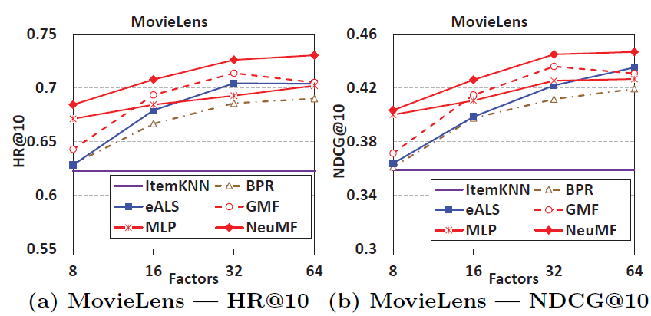
Expected results – MovieLens

Slide 9
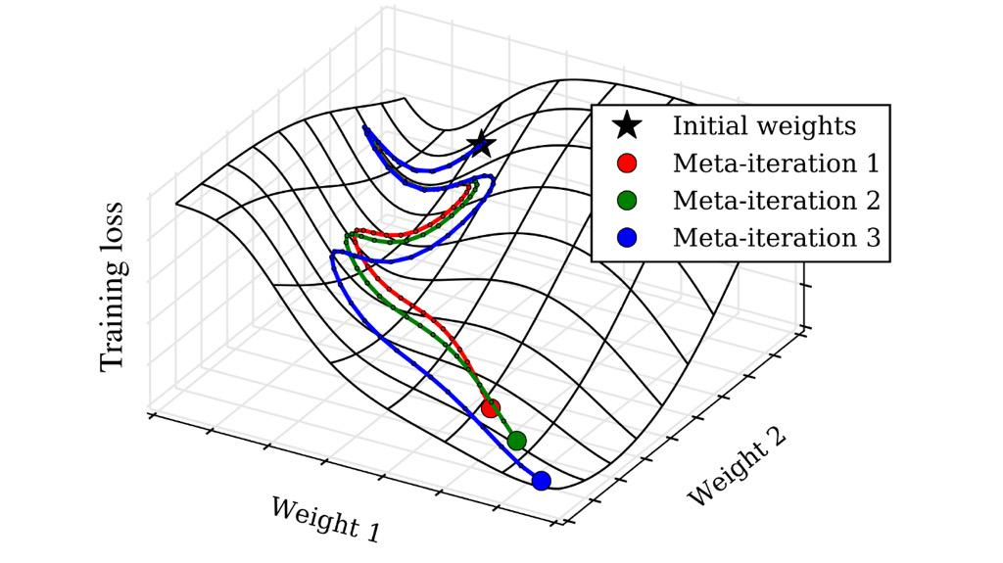
Other concerns (or hyperparams)
Size of embedding
Sampling
Number of layers, size of layers
Regularization
Dropouts
L2
Batch size, learning rate, early stopping, Loss function
Initializers, activations
“Pre training”

Slide 10
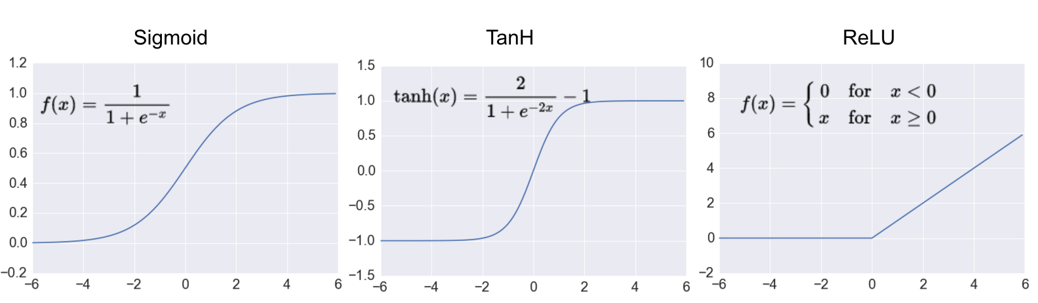
ReLU vs Sigmoid vs TanH

Slide 11
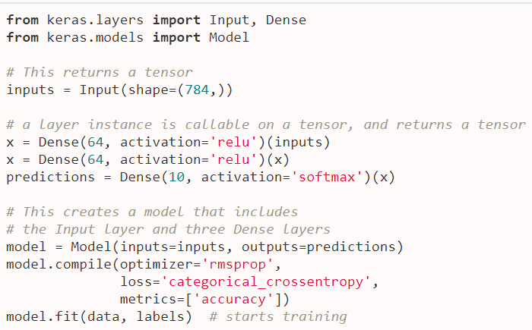
Functional API

Slide 12

Hands on time

Slide 13
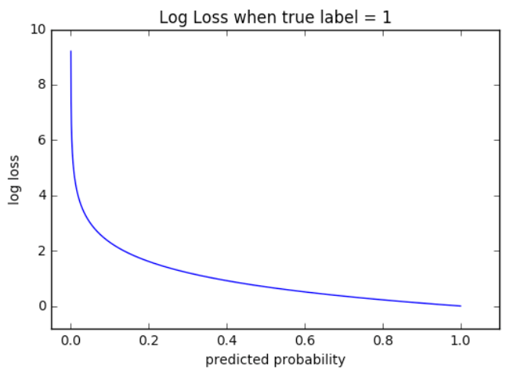
Loss
The paper uses binary_crossentropy

Slide 14
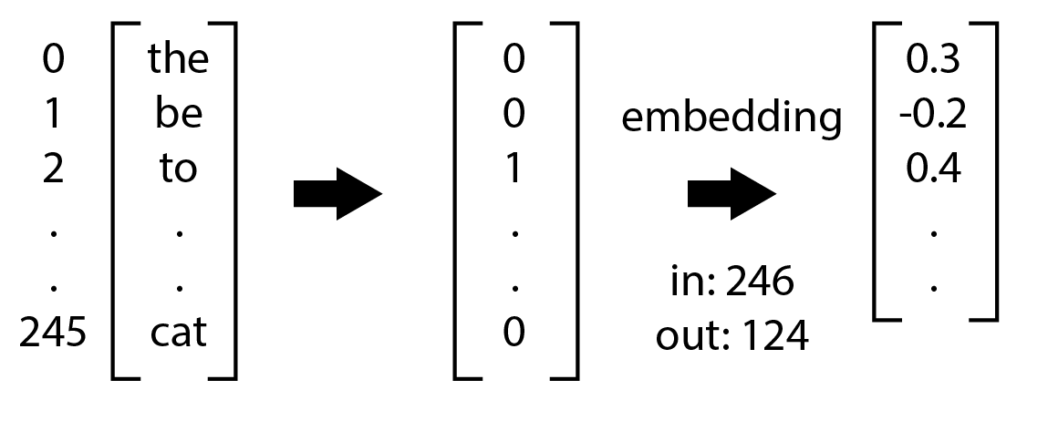
Embedding layers
keras.layers.Embedding
input_dim: number of object @ input
output_dim: size of embedding (size of new feature space)
Item

Slide 15

Multiply
keras.layers.Multiply()

Slide 16
Dense
keras.layers.Dense
Units: size of output space
Activation: activation function (tanh, relu, activation, linear etc.)

Slide 17
Input and outputs
model = Model(inputs=[input1,input2… inputN], outputs=[output1, output2… outputN])

Slide 18
Concat
keras.layers.Concatenate(axis=-1)
[1,2,3] concatenated with [4,5,6] = [1,2,3,4,5,6]

